Slide 1
Quantum Computing Architectures (EE274) Lecture 19
Hiu-Yung Wong
apr. 8, 2025
hiuyung.wong@sjsu.edu, Office: ENG363
http://www.sjsu.edu/people/hiuyung.wong/index.html

Slide 2
Outline
Quantization of SHO
Superconducting Devices
Josephson Junction

Slide 3
Announcement

Slide 4
Quantization of SHO
Chapter 14 of “Quantum Computing Architecture and Hardware for Engineers: Step by Step”

Slide 5
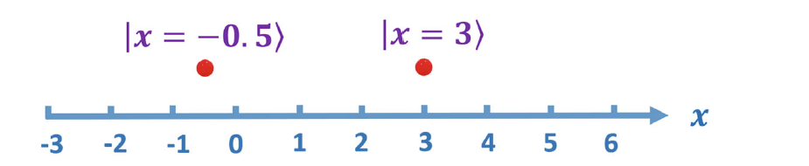
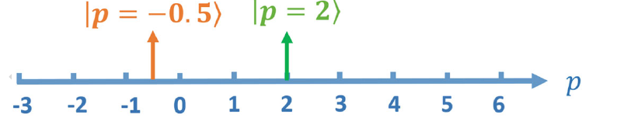
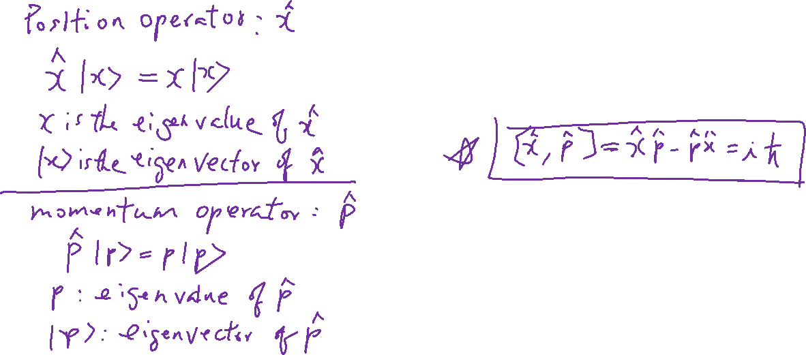
Position and Momentum Operators
From the last lecture

Slide 6
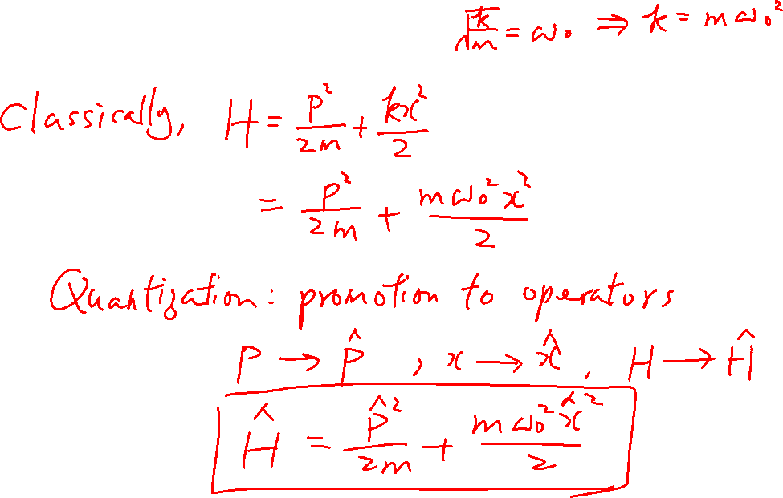
Quantization of SHO
From the last lecture
Learning outcomes: Understand the math and Hamiltonian as a bridge between the classical and quantum mechanics.

Slide 7
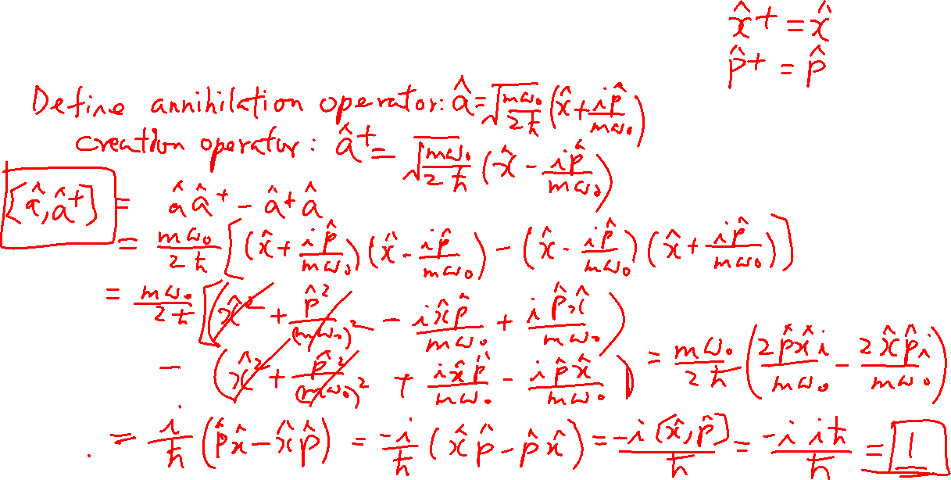
Creation and Annihilation Operators
From the last lecture
Learning outcomes: Understand their relationship to x and p operators

Slide 8
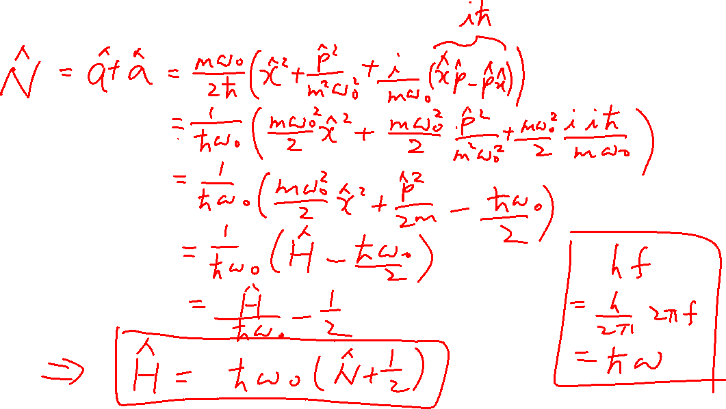
Number Operator
From the last lecture
Learning outcomes: Understand its relationship to a and a⁺

Slide 9
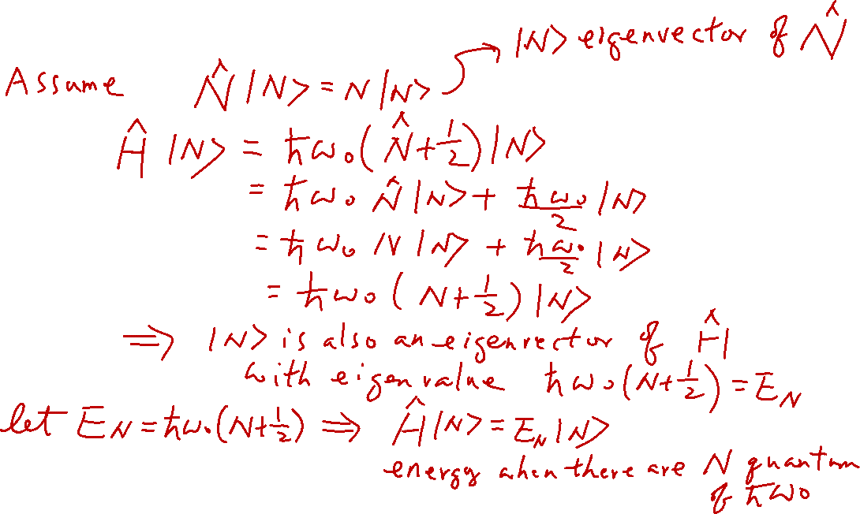
Number Operator
From the last lecture
Learning outcomes: Understand its relationship to a and a⁺

Slide 10
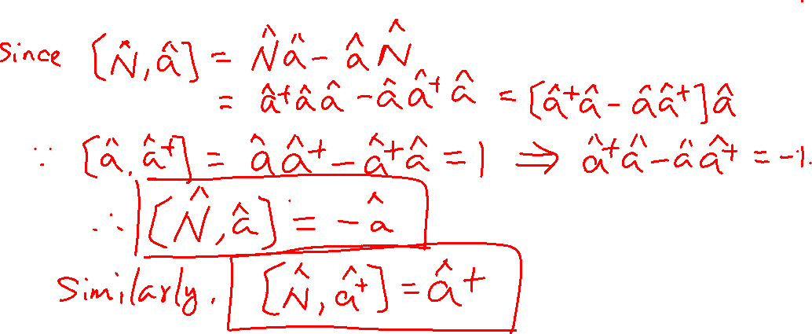
Number Operator
Learning outcomes: Understand its relationship to a and a⁺

Slide 11
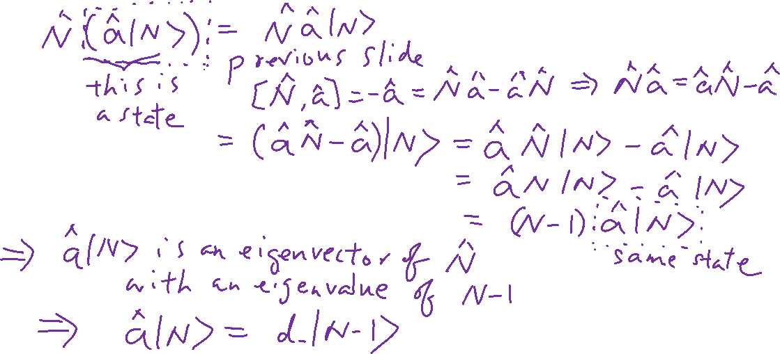
The meaning of the creation and annihilation operators
Learning outcomes: Understand the meaning of a and a⁺

Slide 12
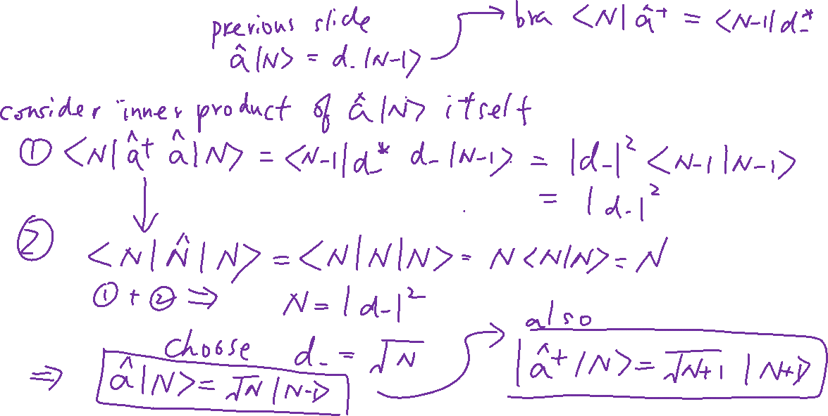
The meaning of the creation and annihilation operators
Learning outcomes: Understand the meaning of a and a⁺

Slide 13
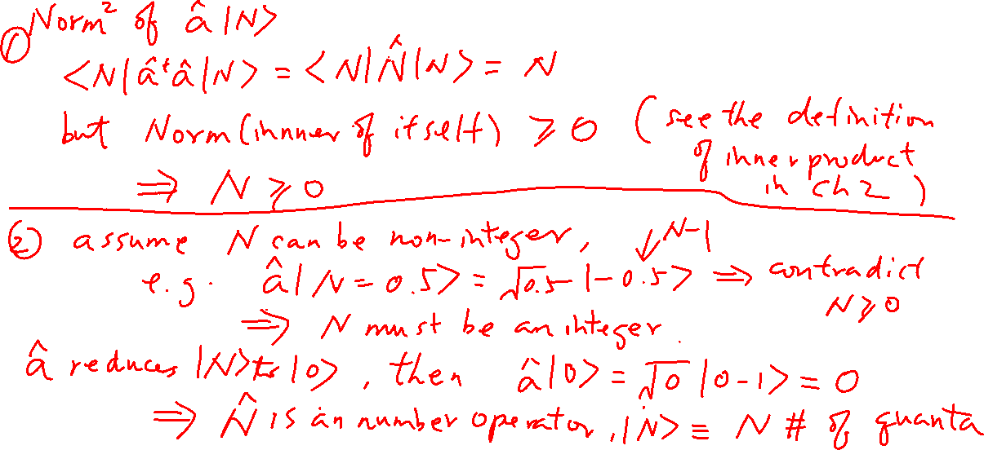
Values of N
Learning outcomes: Understand the range of n

Slide 14
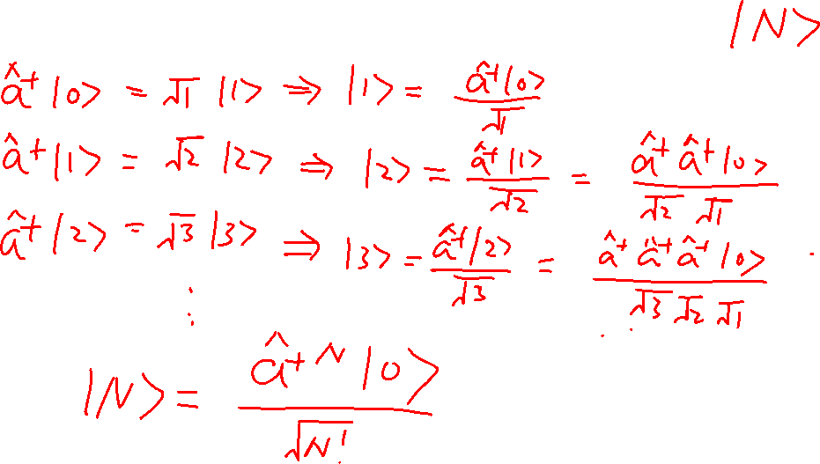
More about the energy eigenstates
Learning outcomes: Construction of the energy eigenstates

Slide 15
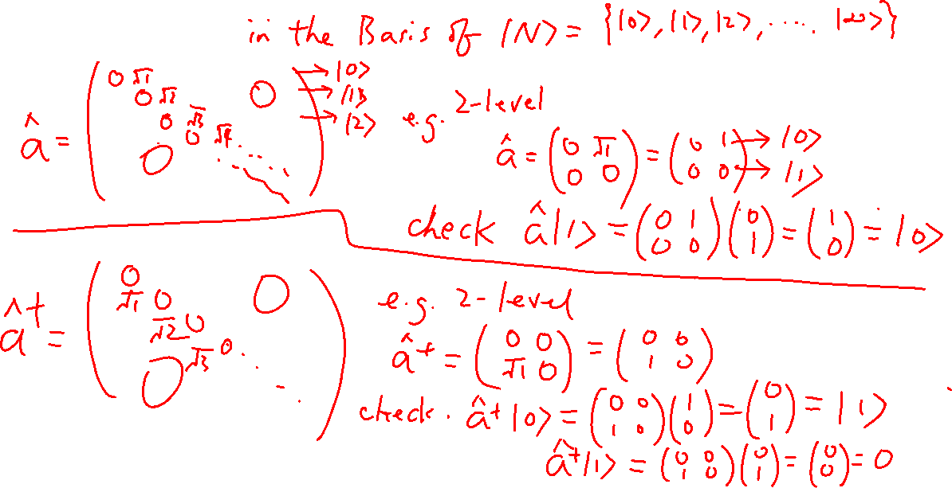
Matrices of the creation and annihilation operators
Learning outcomes: Understand how to construct the matrices

Slide 16
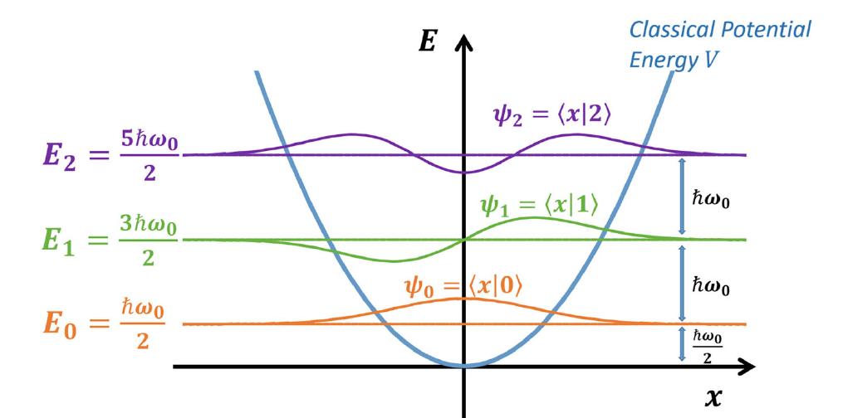
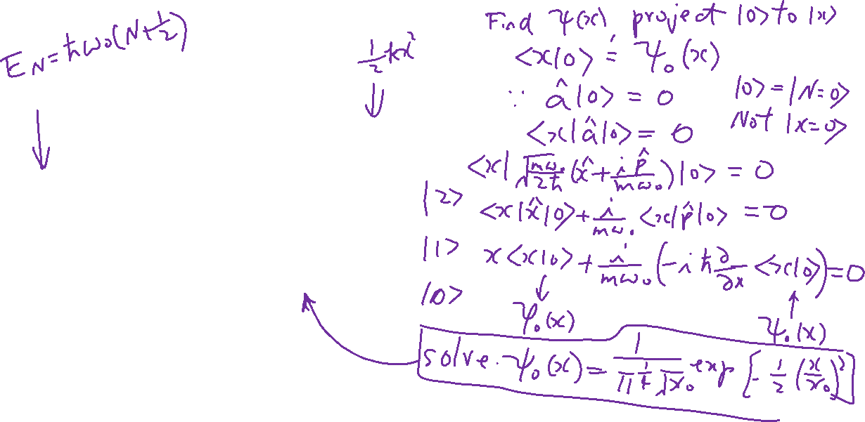
Energy Eigenstate Wave Function
Learning outcomes: Visualize the energy eigenstates
Wiki

Slide 17
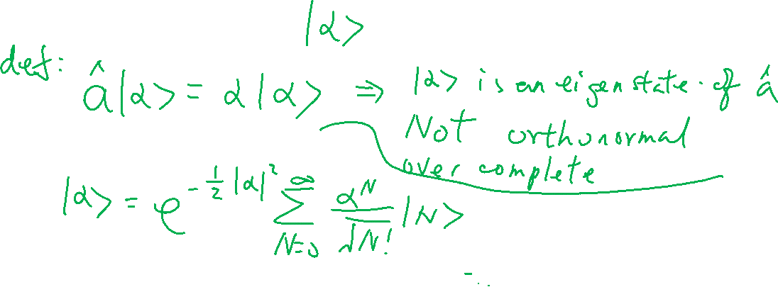
Coherent State
Learning outcomes: Understand the meaning of coherent state
Wiki

Slide 18
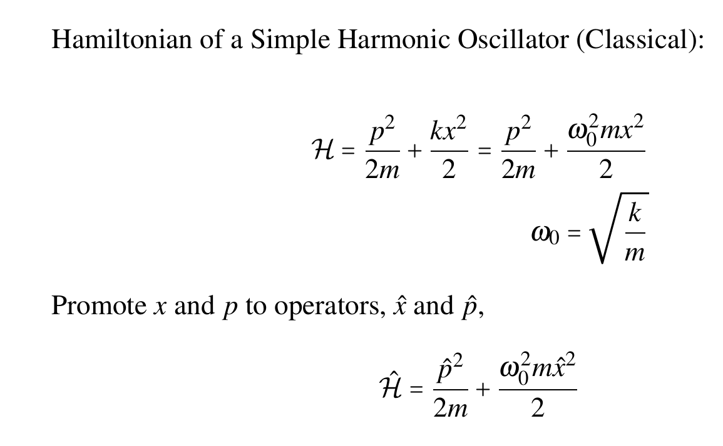
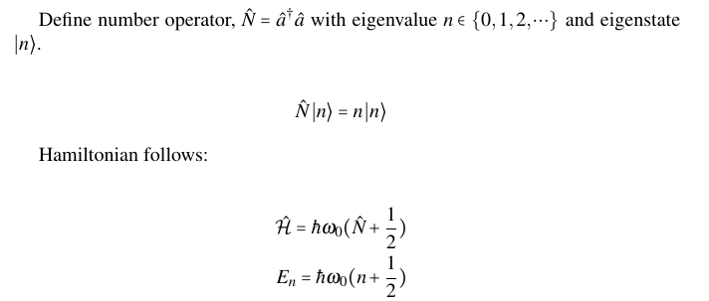

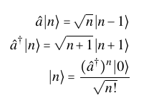
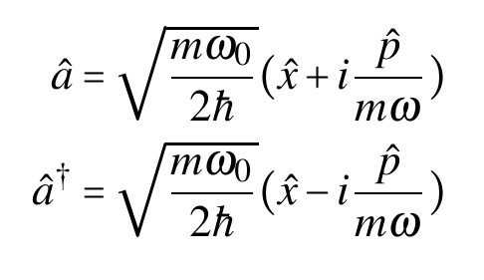
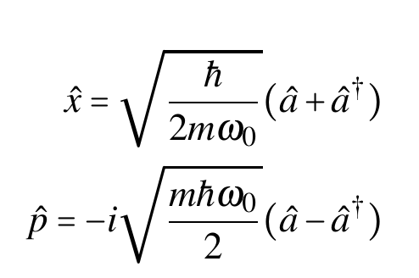

Summary of SHO quantization

Slide 19
Superconducting Device
Chapter 16 of “Quantum Computing Architecture and Hardware for Engineers: Step by Step”

Slide 20
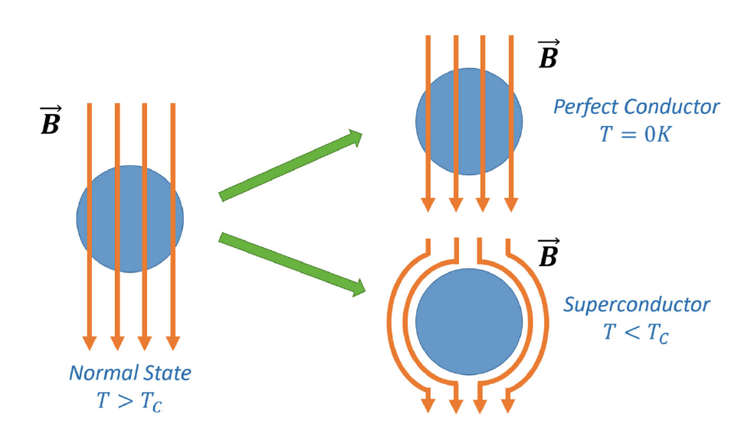
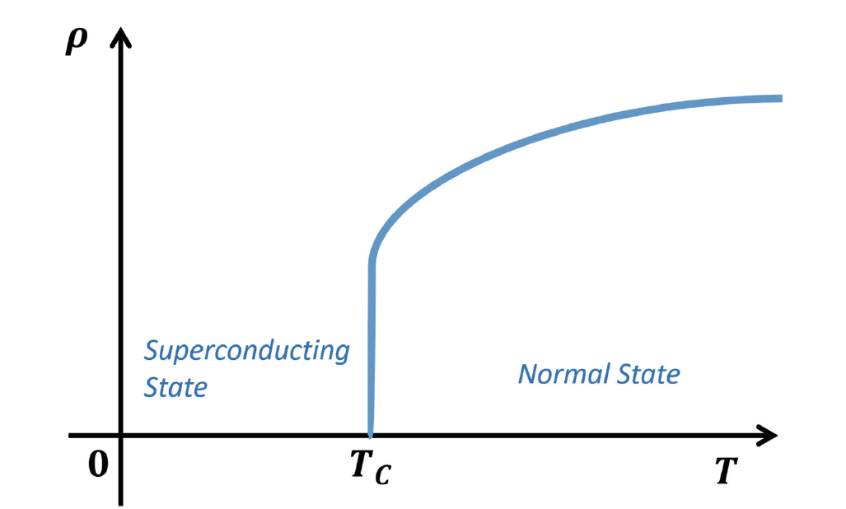
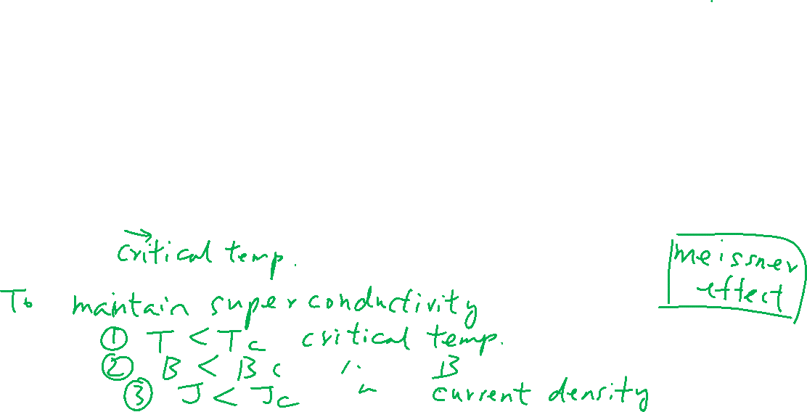
Superconductors
Learning outcomes: Difference between superconductor and perfect conductor

